Slide 1



Slide 2

Problem
The lack of empty/available ICU beds while the demand for beds is still relatively high.
The lack of ease of access towards information about available beds and their location.
1 ICU bed for 1000 Patient in Egypt.
While the average is 10 ICU bed for 1000 watan News.

Slide 3


Solution
Android app shows nearby hospitals with available ICU beds with hospitals details and reviews. So it can be a lifesaving.

Slide 4
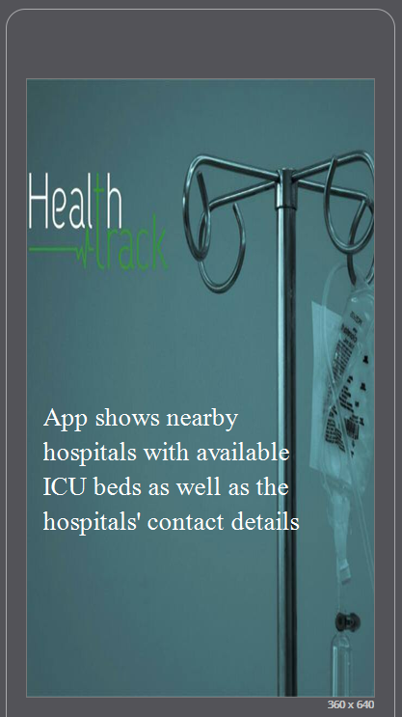
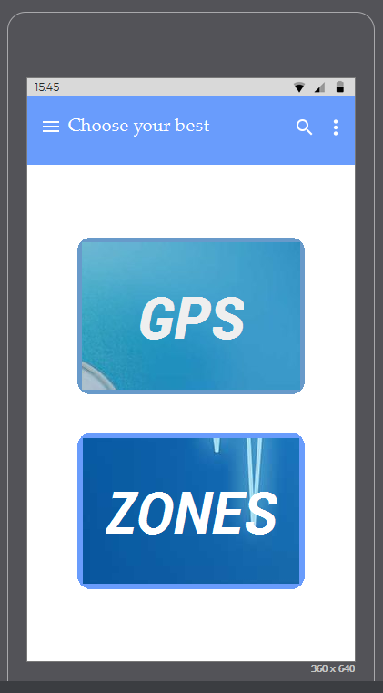
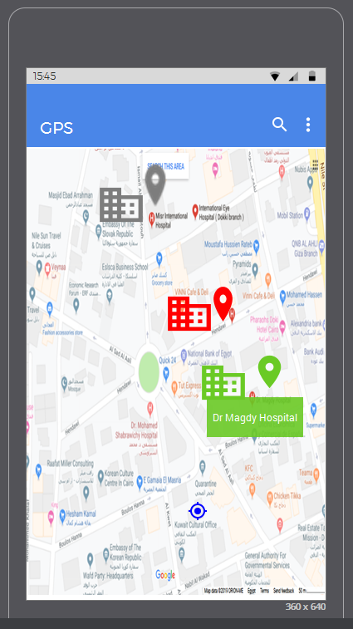
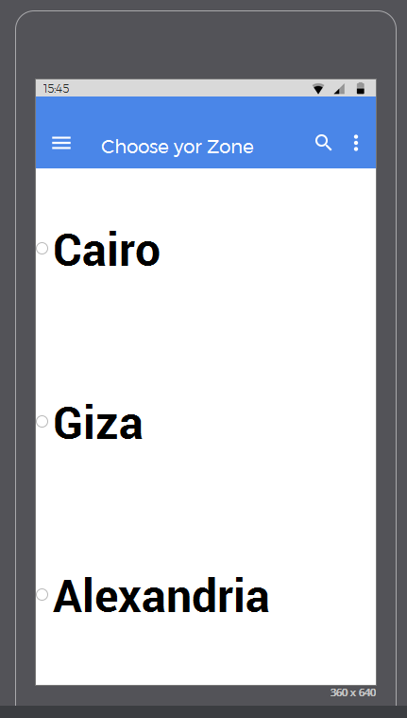
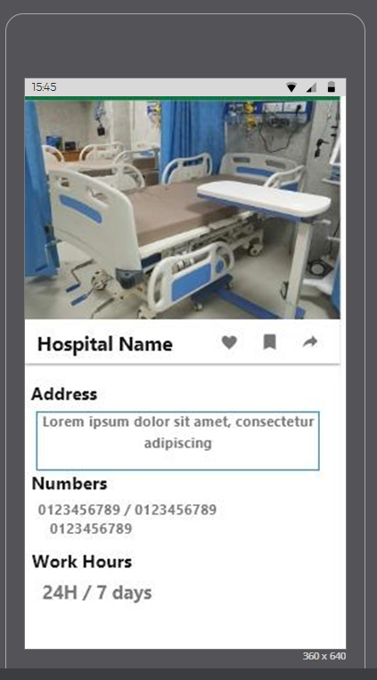

Slide 5



Save A life!
Vision
#Shows nearby hospitals with available ICU beds as well as the hospitals' contact details.
#Access of information about available beds and their location.
#Review of hospitals and its equipment's as well as the doctors.
#Makes it much more easier for patients especially that they're of critical condition most of the time.
#Tracking of Ambulance.
Value Proposition

Slide 6
Market validation

Slide 7
Revenue model
Financials
Monthly fees from the hospitals for adding them on the app.
Advertisement of new hospitals.

Slide 8
team
Muhammad Ibrahim – UX designer.
Nermeen Mohie – Marketer.
Ansam Ahmed – PS designer.
Ameena Bashar – PR.
DR/Waleed Saad – Emergency-Case consultant.

Slide 9


